Slide 1





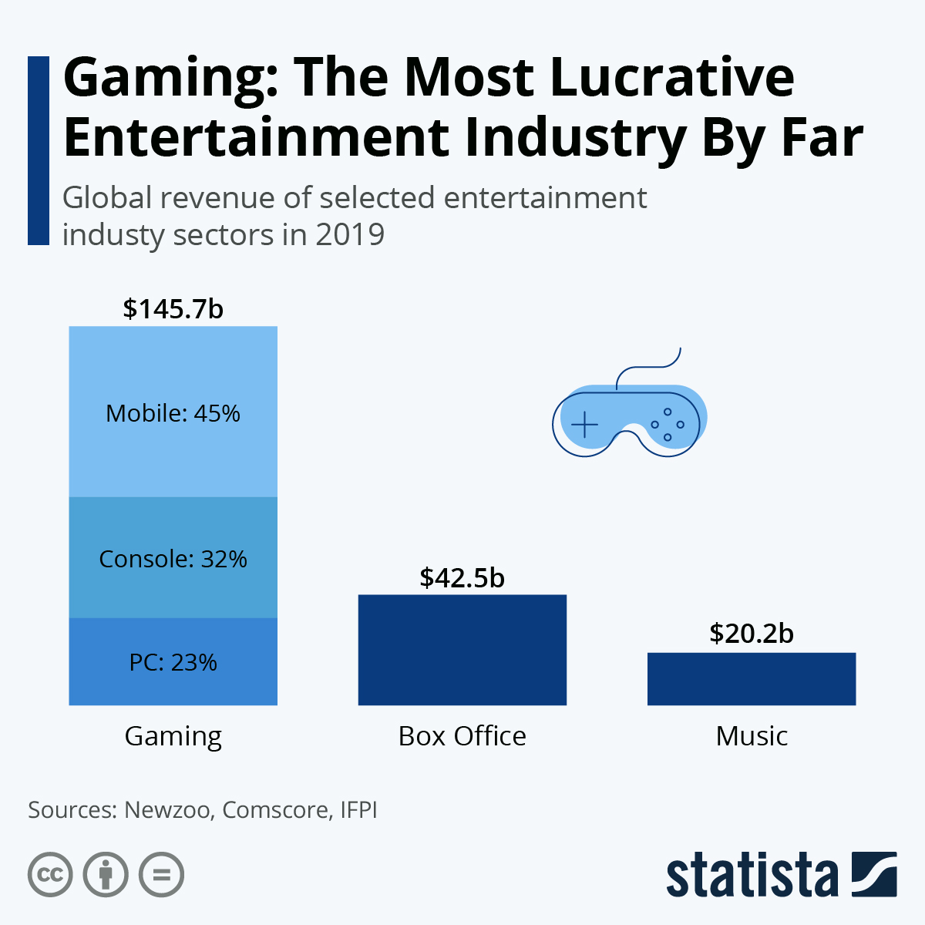
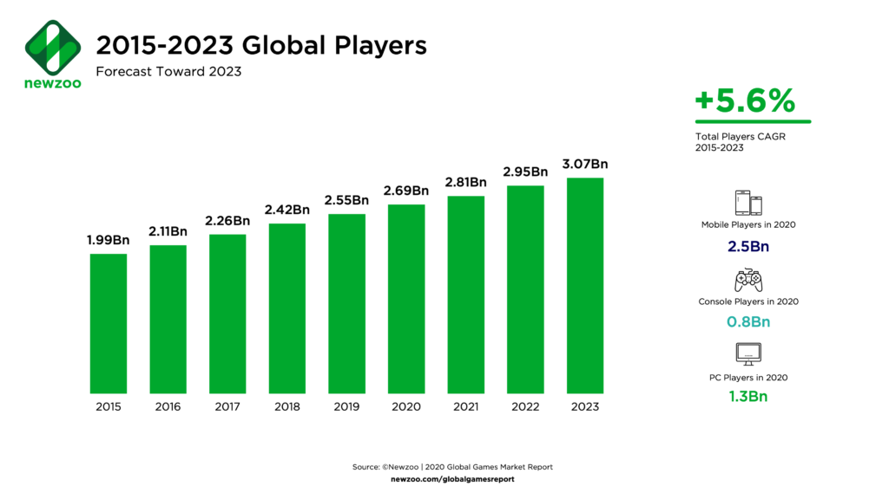
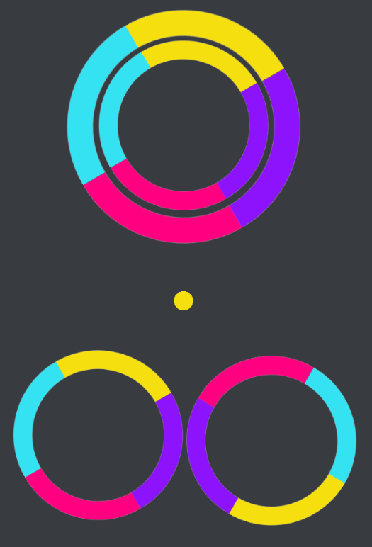
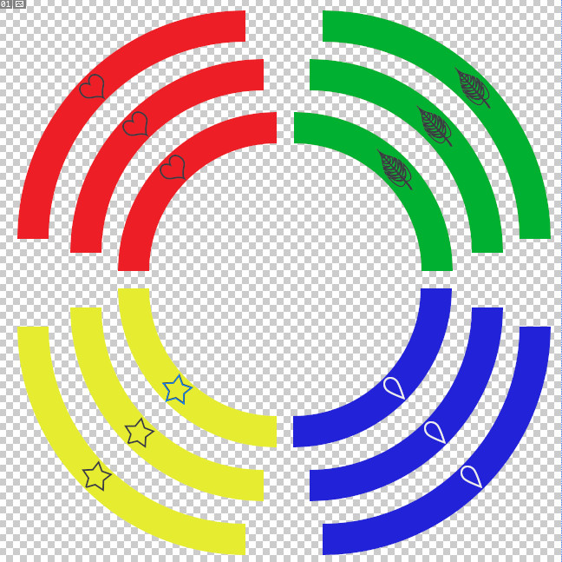


Accessibility in Games
Ian Givero, Student No. 180297269, Supervisor: Graham Morgan
Background
Problem & Motivation
The Proposed Approach
Gaming is the biggest entertainment industry by revenue.
Bigger than the movie and music industry combined!
Over 2 billion gamers across the world. That is 26% of the world’s population [1]
A billion people experience some form of disability, 15% of global population [2]
According to PopCap Games Research, this figure rises to 20.5% among gamers.
Disabled gamers have more video game engagement than casual gamers overall
The main focus for the project is to put more emphasis in accessibility for games
Integrate video game accessibility features to lower barriers to access faced by people with disabilities (“Color Switch” Game)
Accessibility barriers considered: Visual, Motor, and Cognitive Impairment
Aim & Objectives
Implementation Progress
Solution for Motor Impairment Accessibility Barrier
Replace Stimuli: Allow player to use voice commands as an alternative over mouse & keyboard
Solution for Visual Impairment Accessibility Barrier
Replace Stimuli: Add simple shapes that the user can use to associate with certain colours
AIM: TO DEVELOP A UNITY GAME WHICH INCORPORATES ACCESSIBILITY FEATURES TO HELP FACILITATE THE EXPERIENCE AND CHALLENGES ENCOUNTERED BY PLAYERS WITH ACCESSIBILITY ISSUES.
OBJECTIVES:
Explore a set of common gaming accessibility barriers including visual, motor, hearing, and cognitive impairments and investigate established audio-visual techniques that are used to assist players facing such accessibility barriers..
Develop separate, individual unity prototypes or mini-simulations focused on each selected accessibility barrier..
Develop a Unity game that integrates all accessibility techniques into the main game loop.
Analyse and evaluate how well the integrated accessibility features satisfy established accessibility guidelines in gaming such as “game accessibility guidelines” and “includification”
Analyse and evaluate the scalability of the integrated accessibility features in terms of its impact on the game’s performance.
Solution for Cognitive Impairment Accessibility Barrier
Enhance/Reduce Stimuli: Give user the option to increase/decrease game speed
Future Development outside of Project Scope:
Include user-swappable colour themes/palettes
Due to technological limitation (delayed system response), Unity Speech Recognition can be replaced with a more efficient Speech Recognition Software/System.
Directions for Future Work
References: [1] A. Beattie, “How the Video Game Industry Is Changing” Investopedia, Oct. 31, 2021. [Online]. Available: https://www.investopedia.com/articles/investing/053115/how-video-game-industry-changing.asp. [Accessed: Feb. 23,2022]
[2] World Health Organisation, “World Report on Disability,” World Health Organisation, 2011. [Online]. Available: https://www.who.int/disabilities/world_report/2011/report.pdf [Accessed: Feb. 23, 2022]

